Slide 1
Cloud 9 Socials
Brand Identity and Marketing Strategy Presentation
A great digital marketing strategy can drive audience engagement by connecting hospitality services with guests through tailored online strategies. By taking advantage of social media, search engine optimisation, and targeted adverts, businesses can take greater control of their bookings and brand identity. A data driven approach can enable your business to thrive through the application of an efficient digital content campaign, ensuring that you get the most out of every audience interaction.

Slide 2









Brand Identity and Logo Concepts
Varcon
Colour Pallet
Branding Prompts
Contacts Print
Title Case
Information & Links
Body

Slide 3
Marketing Strategy
The Audience
The Goals
Small, independent and new hospitality providers
Event venue managers
Restaurant and café owners
Marketing team leaders
Brand image leaders
Growth in client application & target audience engagement
Establishment of a brand identity, visual identity and tone
Position the business as a trusted organisation
Advertise the services
The Platforms
Facebook, Instagram – for contacting potential clients based on their present digital marketing
LinkedIn – networking to find relevant clients
YouTube – host video case studies based on previous experience

Slide 4
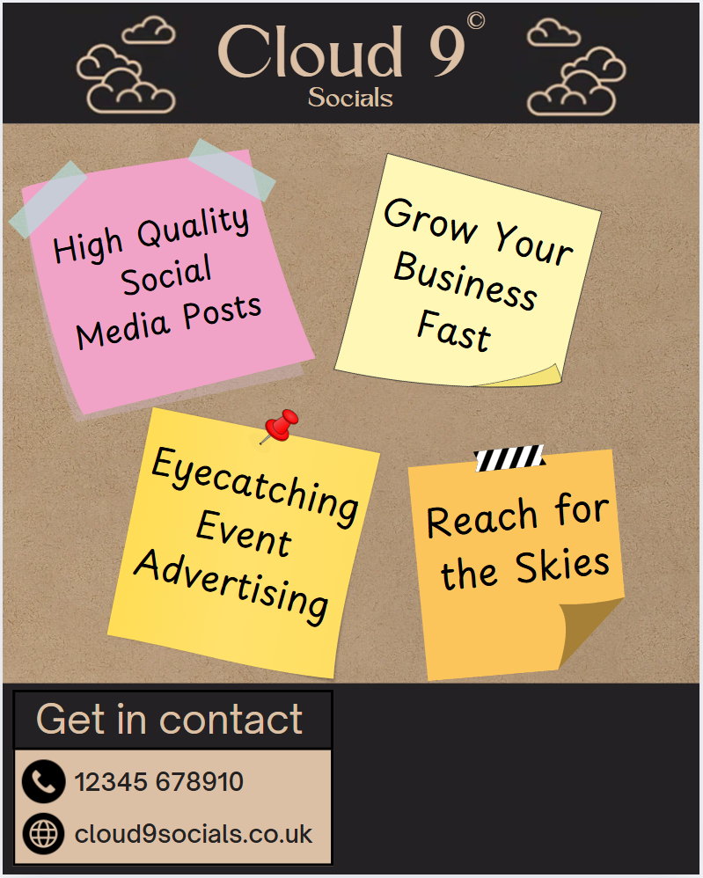
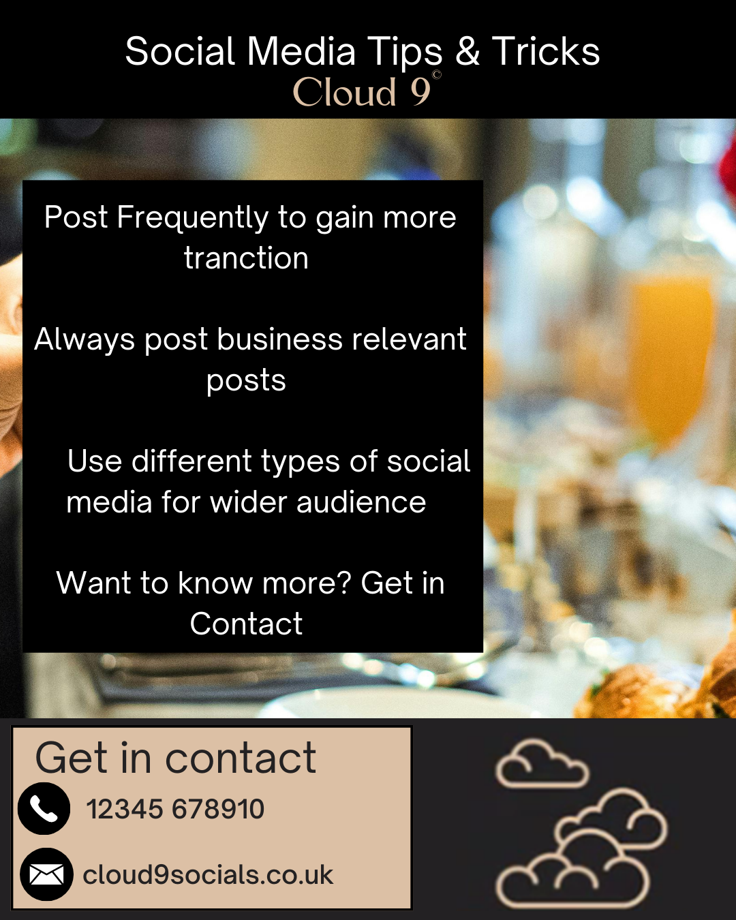
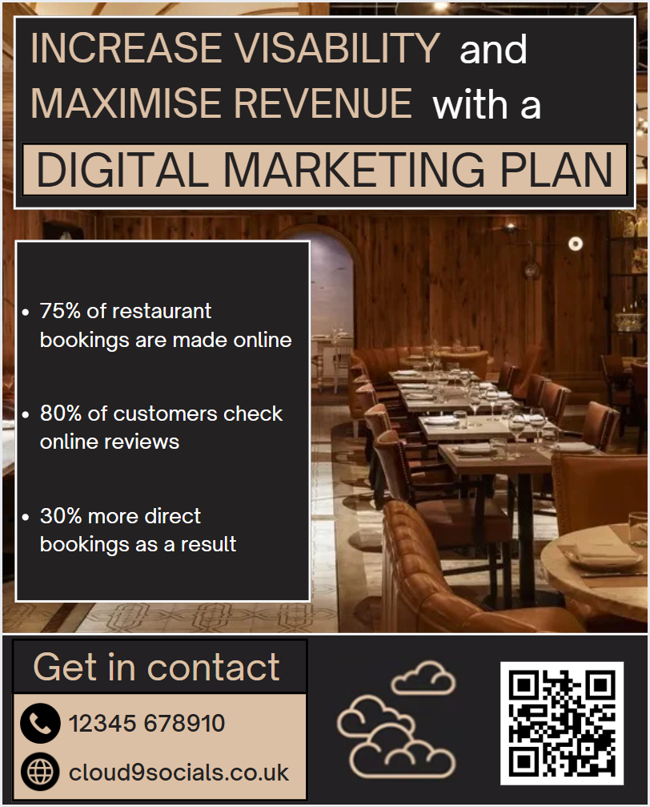
Concept Content
Introductory Post
Tips & Tricks Post
Day | Time | Activity | Goals
Monday | 9am | Facebook: Industry insight post | Present importance of service, showcase knowledge
Tuesday | 9am | Instagram: Brand introduction post | Improve brand awareness, attract new followers
Wednesday | 10am | LinkedIn: Tips & Tricks post | Engage professionals, showcase knowledge
Thursday | 9am | Facebook: Case study post | Showcase client success, build credibility
Friday | 9am | Instagram: Consultation advertisement | Increase number of consultation bookings
Saturday | 10am | LinkedIn: Industry insight post | Present importance of service, showcase knowledge
Sunday | 9am | Facebook: Tips & Tricks post | Engage audience, showcase knowledge
Industry Insight Post

